Slide 1
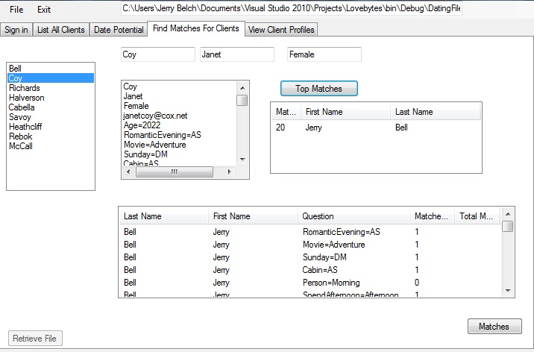
Notes:
Here is our matching section of the program. The selected respondent, Janet Coy’s top match is Jerry Bell. You can also check all of her and his responses to each question responses.

