Slide 1
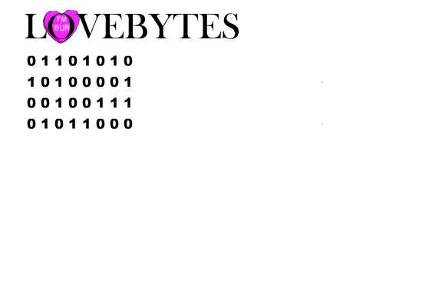
LoveBytes Annual Report May 31, 2014
A computer dating service for young adults

