Slide 1
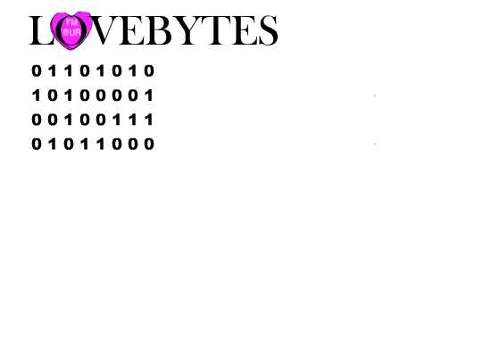
LoveBytes Annual Report May 31, 2014
A computer dating service for young adults

Slide 2
Letter from The CEO
Click icon below to here letter

Slide 3
Marketing/Sales Annual Report June 1, 20XX
Computer Dating Survey
Notes:
The essence of our product line is our dating survey and the specially designed software that matches up clients. The survey is conducted on-line from our web site. Responses and client information is sent to our company email address where our IT Department creates a data base file of respondents.

Slide 4
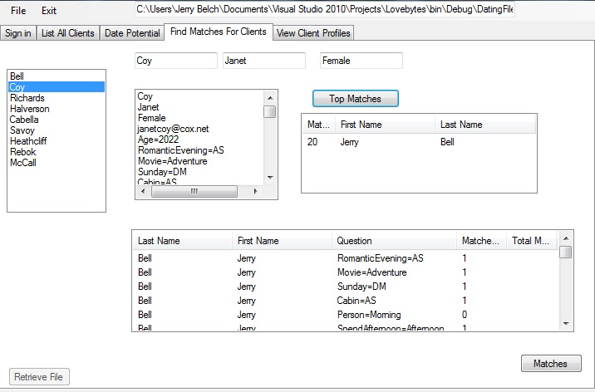
Notes:
Here is our matching section of the program. The selected respondent, Janet Coy’s top match is Jerry Bell. You can also check all of her and his responses to each question responses.

Slide 5
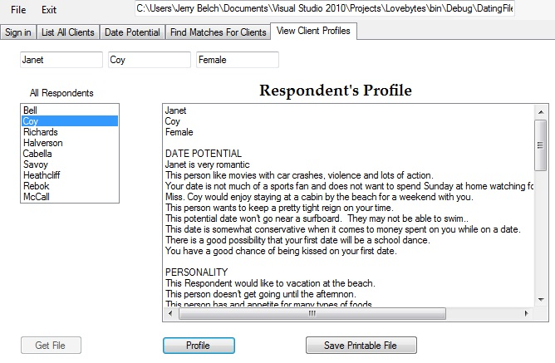
Notes:
Here is the results of the profile page of our program. It is a profile of Janet Coy. The profile is determined by a series of algorithms that are tied to each response in the questionnaire.

Slide 6
Financial Summary
Monthly expenses remained fairly equal
Total revenue was $638,897.89
Net profit was $49,016.30
Profit margin was 7.6%
Our balance sheet showed over $98,000 in cash
We made regular payments on our note.
We had no other liabilities
Notes:
Monthly financial statements were prepared. We entered trial balance totals into a specially designed spreadsheet to get yearly statements. The only month we showed a loss was November. All other months surpassed our break even projections

Slide 7
Management Discussion and Analysis
Company’s Financial Performance
Company’s Current Financial Position
Market Risks
Notes:
We were profitable. We had excellent sales. Changes at Trade Show will increase sales. We plan to attend an additional trade show next year. We will have a grand opening. Plans to convert on-line survey. Depreciation schedule to minimize taxes.

Slide 8
CPA Letter
Financials are in excellent order
All statements present: trial balance, income statement, stockholders’ Equity and balance sheet
Spreadsheet combined all monthly totals
Notes:
Books were closed each month, cash was proved, bank reconciliations provided, accounts receivable recent. Debt limited to Note from VEC, all payroll taxes paid.

Slide 9
Financial Reports Annual Report June 1, 20XX
Financial Statements for LoveBytes
Our loan was for $49,400. Payments were $745.58 each month
Notes:
Top spreadsheet combines all trial balances: November through April. Numbers from April are all asset, liabilities, and stockholders balances. Expenses and revenues are entered from each month’s trial balance. The trial balance appears just below. Sheet 2 shows our yearly income statement and Sheet 3 our balance sheet.

Slide 10
Information Technology Annual Report June 1, 20XX
Watching LoveBytes Work
Task | Result
Web Page | Done
Video Commercial | Done
Year end video | Done
Internet Ad | Next Year
Listed in shopping mall | Done
Competed in competitions | Done
Notes:
We finished our web page using a template. Sections included home, about us, our services page/prices and on-line survey page. We had it hosted by our school server and listed the URL with the VEC office. We competed in both the video commercial and web page design competitions.

Slide 11
Human Resources Annual Report June 1, 20XX
Accomplishments
Monthly Newsletter | Done
Employee Manual | Done
Professional Development | Done
Update company forms | Done
Filing System set up | Done
Employee of the month | Done

